Slide 1
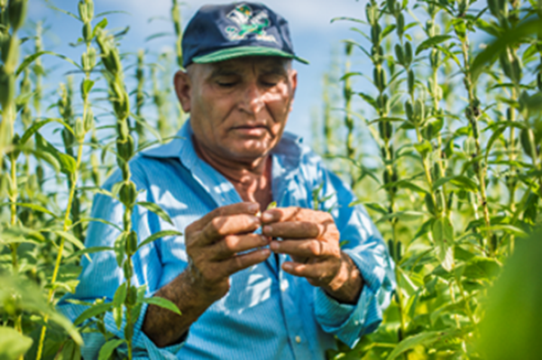
What is it?
Sesame seeds
www.shared-interest.com

Slide 2
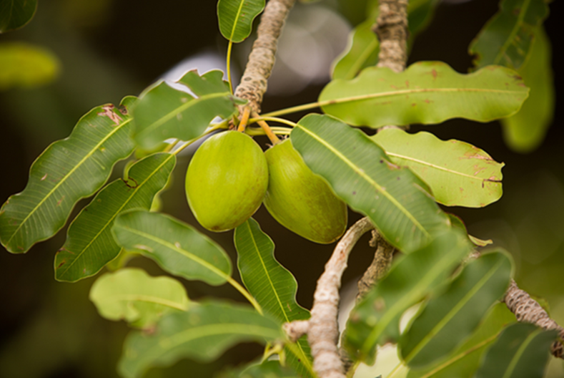
What is it?
Shea nuts (used to make shea butter)
www.shared-interest.com

Slide 3
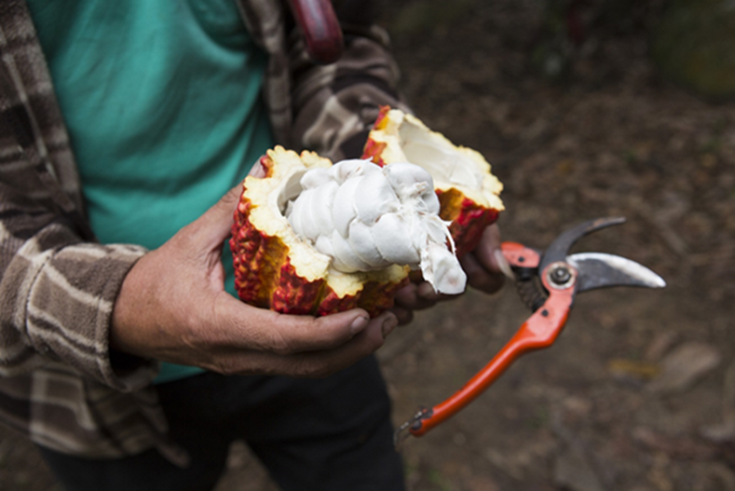
What is it?
Cocoa
www.shared-interest.com

Slide 4
What is it?
Cashew nut
www.shared-interest.com

Slide 5
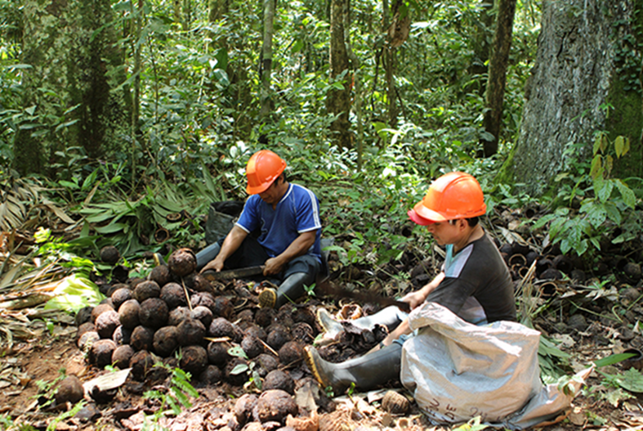
What is it?
Brazil nuts
www.shared-interest.com

Slide 6
What is it?
Vanilla pods
www.shared-interest.com

